Slide 1

Overfitting
Matthew Engelhard
Notes:
Hi Everyone
In previous lectures, we’ve alluded to the idea of overfitting,
in which a model learns to maximize performance on the training set
by exploiting patterns that are unique to the training set
and not likely to be repeated in new, previously unseen data
In this lecture, we’ll explore this idea in more detail,
We'll see how, and why, we use proper model validation to avoid overfitting
And ensure our models will generalize – meaning they will perform well on data they haven’t seen before
By the end of this lecture, you should be able to define overfitting
describe the model development and validation process
And understand why it is necessary

Slide 2

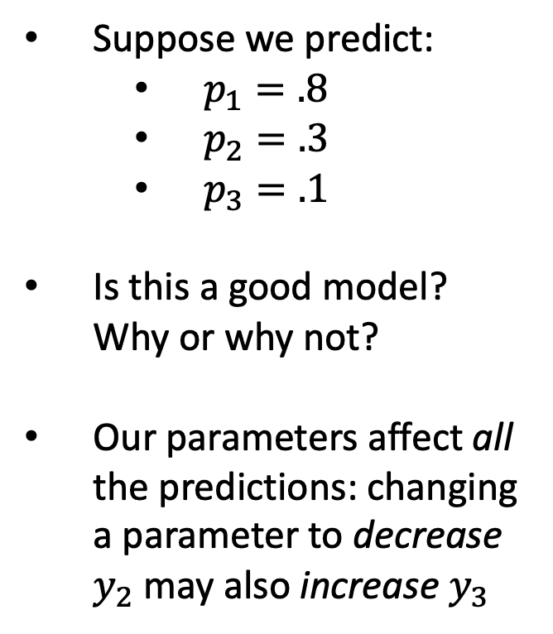
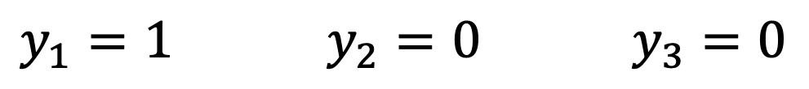
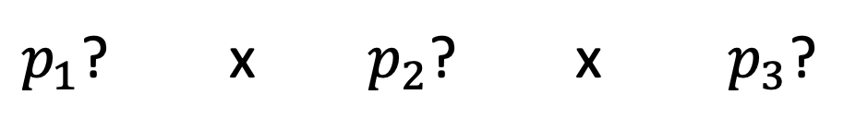
Recall: improving one prediction may worsen another
Suppose we predict:
$p_{1}=.8$
$p_{2}=.3$
$p_{3}=.1$
Is this a good model? Why or why not?
Our parameters affect all the predictions: changing a parameter to decrease $y_{2}$ may also increase $y_{3}$
$y_{1}=1$ $y_{2}=0$ $y_{3}=0$
(dies) (survives) (survives)
$p_{1}$? x $p_{2}$? x $p_{3}$?
Notes:
In the previous lecture, we talked in detail about what makes a model good or bad
Intuitively, we said the model is good when its predictions are aligned with the outcomes
And to make that more precise – more mathematical – we need to think about the probability of the outcomes that were actually observed
Supposing our model were correct.
This is called the likelihood – and for us, a better model means a higher likelihood
Now, the highest possible likelihood for any model would be 1, meaning the observed outcomes were guaranteed supposing the model were true
But something doesn’t seem right about this – our experience tells us that this doesn’t align with reality, since there’s randomness in outcomes
And in most cases, this is beyond the capabilities of our models.
We might be able to adjust our parameters to get p_1 up to 1, for instance, but it’ll probably make predictions worse on some of our other patients
And we’re trying to make the best predictions we can, on average

Slide 3
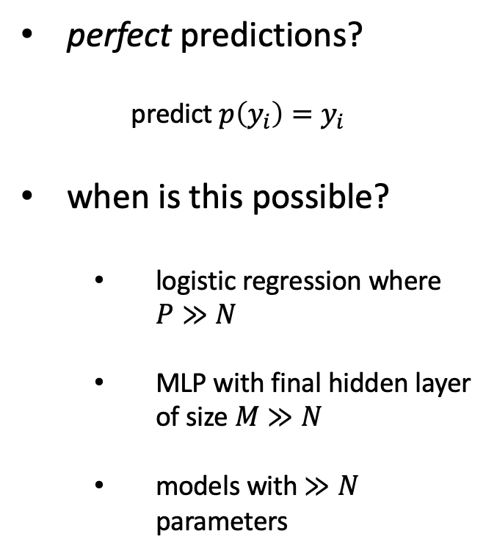
With a big enough model, this is no longer true.
perfect predictions?
predict $p\left(y_{i}\right)=y_{i}$
when is this possible?
logistic regression where $P≫N$
MLP with final hidden layer of size $M≫N$
models with $≫N$ parameters
$y_{1}=1$ $y_{2}=0$ $y_{3}=0$
(dies) (survives) (survives)
$p_{1}$? x $p_{2}$? x $p_{3}$?
Notes:
However, there are some situations in which it IS possible to make perfect predictions –
In other words, to predict for every patient that the observed outcome occurred with probability 1
It’s possible in logistic regression when the number of predictors is greater than the number of patients, or more generally, the number of cases
By extension, it’s also possible for multilayer perceptrons (i.e. neural network models), where the number of units in the final hidden layer is larger than the number of cases
Or more generally, models that have many more parameters than we have cases
Whatever the situation, when we get a model that behaves this way – again, this typically requires a large number of parameters, and often those parameters have to be very large in magnitude –
The model is perfectly tuned to the training set but not to reality, and it rarely performs very well on data it hasn’t yet seen before

Slide 4
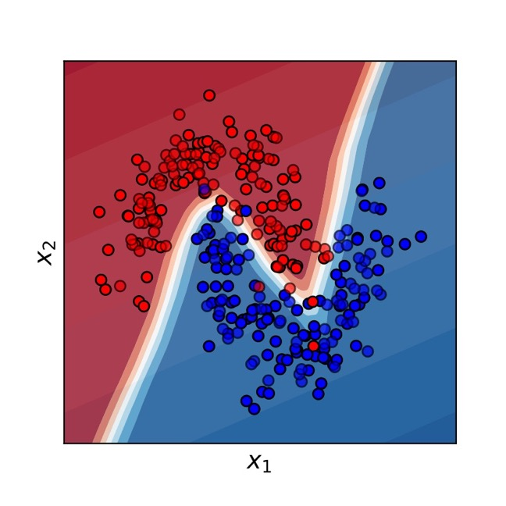
We like flexible, non-linear decision boundaries…
Notes:
Now, we really like to have flexible models, because they can more accurately approximate the true relationship between the data and the labels, and in general, there’s not much reason for that relationship to be linear
So, for many problems, more flexible models give us better prediction performance
Here’s an example of a model that’s dividing the blue points from the red
A multilayer perceptron will solve this problem effectively – that is, with high accuracy – whereas logistic regression cannot, because the divider it places between the red points and blue points – the decision boundary, in other words – will always be linear

Slide 5
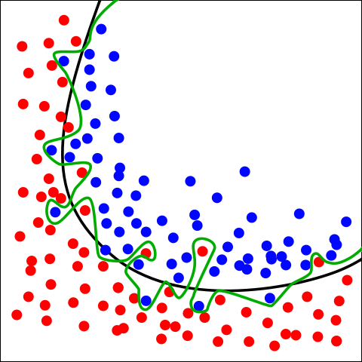
But when we start making our decision boundary arbitrarily complex to `fit’ the training set… this is overfitting
Green boundary:
Correct predictions for all training data
Very likely to be overfitting
Black boundary:
Balance between fit and model complexity
-> The black boundary is likely to perform better on new data
By Chabacano - Own work, CC BY-SA 4.0, https://commons.wikimedia.org/w/index.php?curid=3610704
Notes:
However, it’s possible to have a model that’s too flexible –
In some cases, we can have a decision boundary that can bob and weave around the feature space as much as it needs to
To make perfect predictions on the training set
The green boundary is an example of this – we’d say it’s overfitted – whereas the black boundary seems like it’s probably doing a better job capturing the “real” relationship between the coordinates and the labels
Now, it’s worth commenting briefly on our intuition about this.
Part of that intuition comes from our belief – from experience – that data in the real-world are noisy
And so when we look at this plot, our prior beliefs lead us to look for a simple, clear pattern… with some noise added
When we see a red point sandwiched between a bunch of blue points, we tend to think – and usually rightly so – that if another point appeared right next to it, it’d likely be blue
Now, it’s possible that our intuitions are wrong – it’s possible that the green boundary is actually best
How can we know for sure?
We can evaluate both boundaries on new data – data that wasn’t used to develop the boundary
This is what we do in machine learning.
If the boundary does a good job capturing the true relationship between predictors and labels, it’ll generalize well to new data – data it hasn’t yet seen before

Slide 6
Overfitting
“Overfitting” happens when the learned model increases complexity to fit the observed training data too well – will not work to predict future data!
What would we want to use to fit these example data points?
Notes:
As another example of overfitting – and as a reminder that overfitting isn’t limited to classification problems – let’s consider possible polynomials we might fit to these observations

Slide 7
With a complex enough model, we can typically predict our training labels perfectly.
The simpler model is likely
best with limited data
May be justified;
the validation set will tell us
Perfect predictions,
but unlikely to generalize
Notes:
On the left, we have a line of best fit
In the middle, we have a 3rd order polynomial, which seems to give us a good balance – it fits the training data well – better than the linear model -- but not perfectly
Finally, on the right, you should be yelling that we're overfitting – here we have an 8th order polynomial fitted to just 8 data points
In this case we have more model parameters than data points, and as a result, we’re able to fit the points perfectly
This model seems to be far too flexible – it works well on these points, because it was designed to work well on those points, but it’s hard to imagine it would make accurate predictions for new observations
To know for sure, we can actually try it – we can check how well all of them perform on some new observations
And then we can choose whichever one of these models performs best

Slide 8
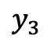
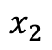
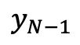
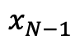
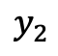
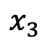
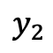
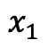
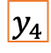
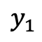
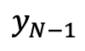
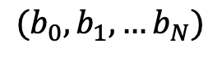
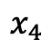
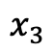
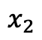
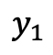
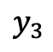
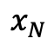
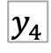
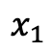
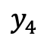
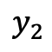
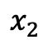
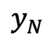
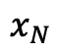
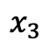
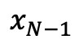
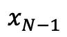
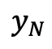
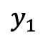
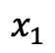
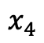
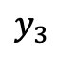
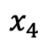
To protect against overfitting, see how well the model performs on previously unseen data.
Refine Model
$$x_{1}$$
$$y_{1}$$
$$x_{1}$$
$$y_{1}$$
$$x_{2}$$
$$y_{2}$$
$$x_{2}$$
$$y_{2}$$
$$x_{3}$$
$$y_{3}$$
$$x_{3}$$
$$y_{3}$$
$$x_{4}$$
$$y_{4}$$
$$x_{4}$$
$$y_{4}$$
$$x_{1}$$
$$y_{1}$$
$$x_{N−1}$$
$$x_{2}$$
$$y_{2}$$
$$x_{N−1}$$
$$y_{N−1}$$
$$x_{N}$$
$$y_{N}$$
$$x_{3}$$
$$y_{3}$$
$$x_{N}$$
$$y_{N}$$
Training Set
$$x_{4}$$
$$y_{4}$$
Test
$$x_{N−1}$$
$$y_{N−1}$$
$$x_{N}$$
$$y_{N}$$
$({b_{0},b}_{1},…b_{N})$
Validation
Estimate Performance on Validation Set
Final Performance Evaluation
Notes:
This is so important that it’s formalized in the concepts of training set, validation set, and test set, as we’ve discussed
The training set and validation set are used repeatedly when developing a model
We directly tune model parameters on the training set, and then we use the validation set to estimate generalization performance – in other words, to estimate whether we’ve overfitted
The validation set can be used in the process in a number of ways
We can use it to choose between models
Or to decide on hyperparameters – these are characteristics of the model that we fix prior to training, such as the number and size of the hidden layers in a multilayer perceptron
A very common hyperparameter is the regularization strength – in other words, how strongly we’re penalizing large model parameters
Regularization helps prevent overfitting, but it also makes our model less flexible, so we can use the validation set to help us figure out how strongly we should regularize
Importantly, by the time we’re done with our iterative model development process, we’re likely to be overfitted to the validation set – we’ve tweaked our model so many times on that
Validation set that it’s no longer giving us a fair estimate of generalization performance
That’s why it’s so important to estimate performance on data that hasn’t been seen before
Our goal is to never use the test set, in any way, until we’ve settled on a final model
If we cheat by evaluating on the test set during model development, we’re no longer getting an unbiased estimate of performance

Slide 9
Early Stopping
During optimization, we can check the validation loss as we go.
Instead of optimizing to convergence, we can optimize until the validation loss stops improving
Saves computational cost
Performs better on validation (and test) sets
Widely used technique in the field
Best Validation (and Generalization) Here
Training Loss Keeps Improving
Notes:
One important way to use the validation set, which is very common when training neural networks,
Is to monitor performance on the validation set repeatedly during training
As long as performance on the validation set is improving, we keep fine-tuning our model’s parameters by following the gradient of the loss
But when validation performance starts getting worse, we’re overfitting, so we stop training and lock in our current model parameters
Using the validation set in this way is called “early stopping”, and we’ll use it when training our neural network models both in scikit-learn and in tensorflow

Slide 10
Conclusions
Greater model complexity is often, but not always, advantageous
Overfitting refers to learning and exploiting patterns in the training set that are not repeated in a new sample, including the validation and test sets
Proper model validation is critical to estimate real-world performance and mitigate overfitting
Notes:
In conclusion…
Thanks and see you in the next lecture.

